Slide 1
Commonly Used Datasets for ML
J.-S. Roger Jang (張智星)
jang@mirlab.org
http://mirlab.org/jang
MIR Lab, CSIE Dept.
National Taiwan University

Slide 2
Datasets
There are numerous datasets for testing machine learning algorithms for classification:
Kaggle
UCI Machine Learning Repository
Image net
MNIST handwritten digit database
Labeled Faces in the Wild
Many many more…
Try “license plate dataset” in Google!

Slide 3
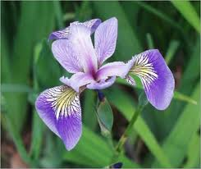
UCI Dataset: Iris
Source
R.A. Fisher, 1936
Goal
Predict the types of iris in Hawaii
Dataset specs
150 instances, 3 classes
4 attributes (features)
sepal length
sepal width
petal length
petal width

Slide 4
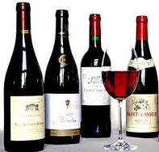
UCI Dataset: Wine
Source
Institute of Pharmaceutical and Food Analysis and Technologies, Via Brigata Salerno, 16147 Genoa, Italy.
Goal
Using 13 chemical constituents to determine the origin of wines
Dataset specs
178 instances, 3 classes, 13 attributes

Slide 5
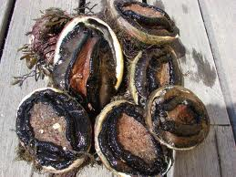
UCI Dataset: Abalone
Source
Dept. of Primary Industry and FIsheries, Tasmania, Australia
Goal
Predict the age of abalone (鮑魚)
Dataset specs
4177 instances, 29 classes
8 attributes (features): sex, length, diameter, height, whole weight, shucked weight, viscera weight, shell weight
1 output: rings (+1.5 gives the age in years)

Slide 6
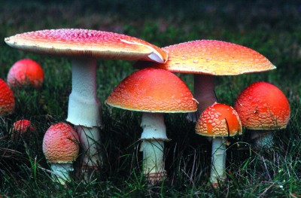
UCI Dataset: Mushroom Classification
Source
Mushroom records drawn from The Audubon Society Field Guide to North American Mushrooms (1981)
Goal
To determine a mushroom is poisonous or edible
Dataset specs
8124 instances, 2 classes, 22 attributes

Slide 7
UCI Dataset: Liver Disorder
Source
BUPA Medical Research Ltd.
Goal
Use variables from blood tests and alcohol consumption to see if liver disorder exists
Dataset specs
345 instances, 2 classes, 6 attributes (the first five are results from blood tests, the last one is alcohol consumption per day)

Slide 8
UCI Dataset: Credit Screening
Source
Chiharu Sano, csano@bonnie.ICS.UCI.EDU
Goal
Determine people who are granted credit
Dataset specs
125 instances, 2 classes, 15 attributes

Slide 9
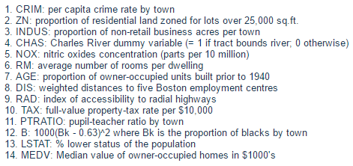
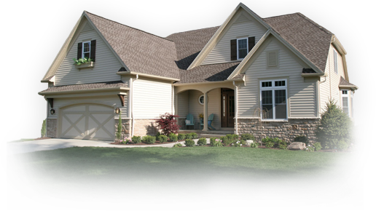
UCI Dataset: House Price Prediction
Source
CMU StatLib Library
Goal
Predict house price near Boston
Dataset specs
506 instances, 13 attributes

Slide 10
MNIST Digit Dataset (1/2)
Source
NIST's Special Database 3 (collected among Census Bureau employees) and Special Database 1 (collected among high-school students)
Goal
Recognize isolated hand-written digits of 0-9
Dataset specs
70000 instances
60000 for training (30000 from SD-3 and 30000 from SD-1) of about 250 writers
10000 for test (5000 from SD-3 and 5000 from SD-1)
Normalized to 28x28 gray-scale image, centered by gravity
Disjoint
writers!

Slide 11
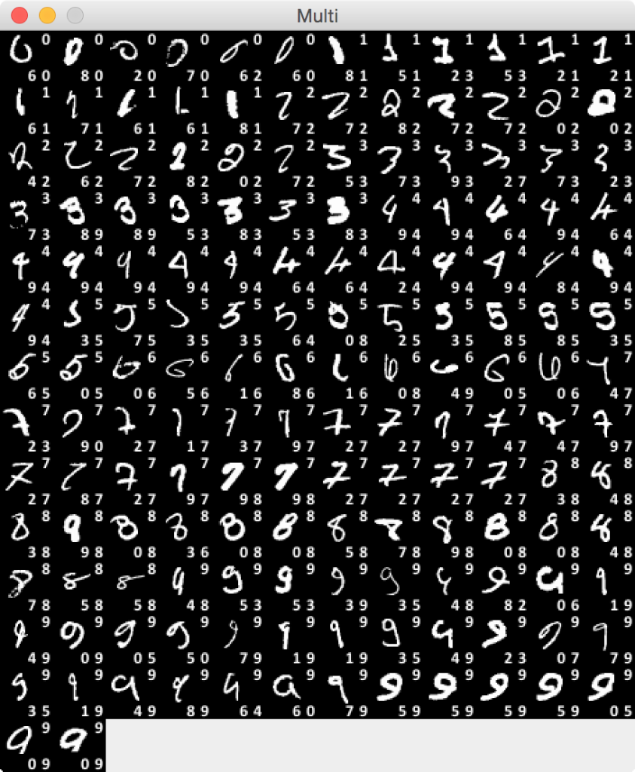
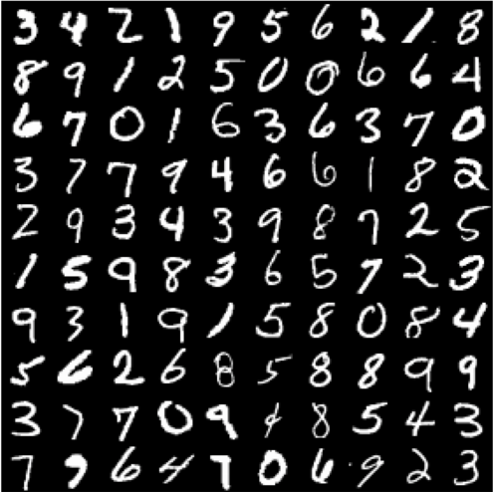
MNIST Digit Dataset (2/2)
Misclassified
digits
Links
Data source
Wikipedia
Examples
Predictions 1 & 2
GT

Slide 12
How to Acquire/Visualize the Datasets?
Acquire the datasets
prData.m for acquiring PR data
dcData.m for acquiring DC data
Visualize the datasets
Please refer to Chapter 2 of DCPR tutorial
Example:
You need to download
Machine Learning Toolbox
to try these commands.
>> ds=prData('iris')
ds =
dataName: 'iris'
inputName: {'sepal length' 'sepal width' 'petal length' 'petal width'}
outputName: {'Setosa' 'Versicolour' 'Virginica'}
input: [4x150 double]
output: [1x150 double]

Slide 13
Iris Dataset Visualization (1/2)
ds=prData('iris');
classSize=dsClassSize(DS, 1);
ds=prData('iris');
dsDistPlot(ds);

Slide 14
Iris Dataset Visualization (2/2)
ds = prData('iris');
dsProjPlot1(ds);
ds = prData('iris');
dsProjPlot2(ds);
ds = prData('iris');
dsProjPlot3(ds);

